Slide 1

INFO-6001
Information Security
LAB ASSIGNMENT 7
Password Cracking
SUBMISSION TEMPLATE

Slide 2
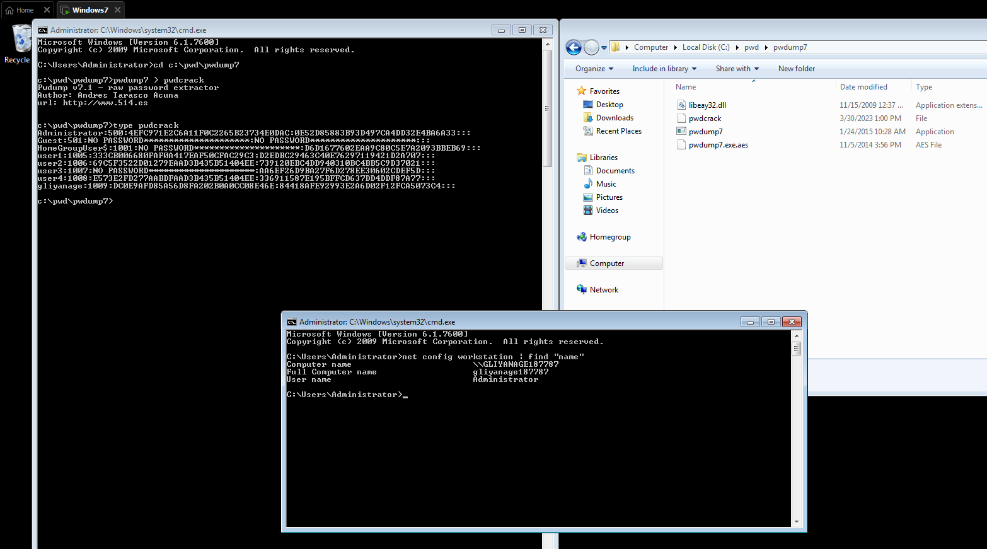
Screen Shot 1
2

Slide 3
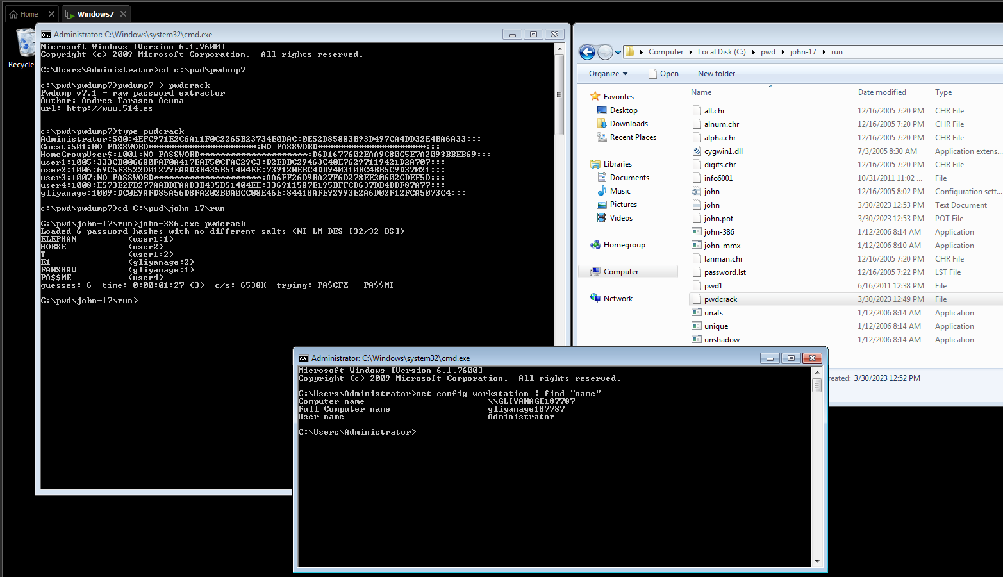
Screen Shot 2
(Answer to question) First password cracked: ELEPHANT
3

Slide 4
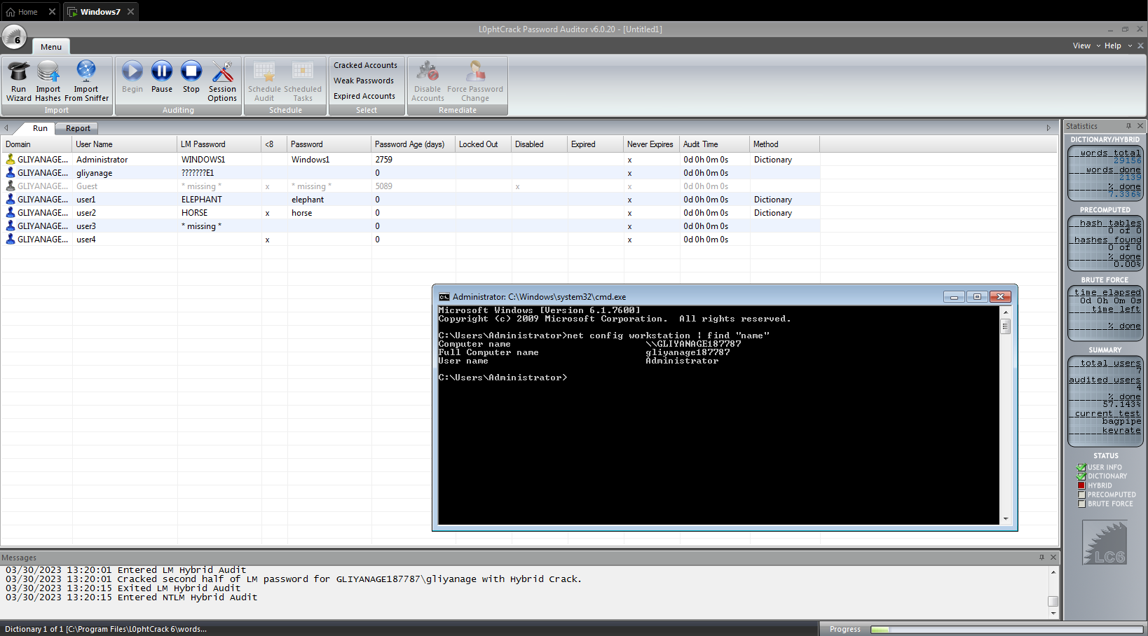
Screen Shot 3
4

Slide 5
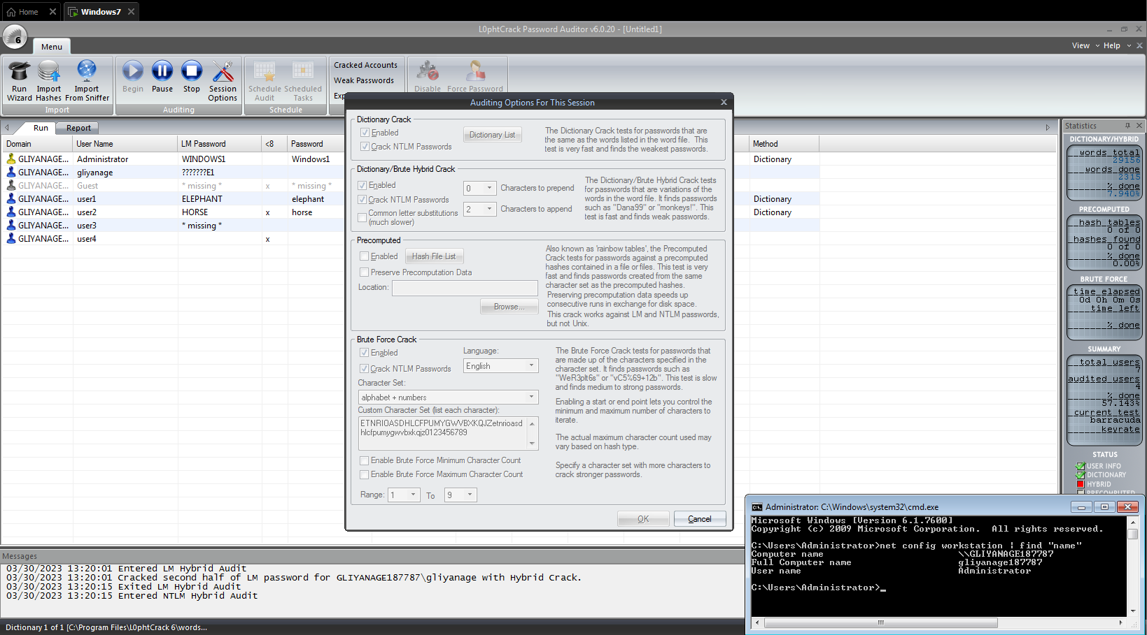
Screen Shot 4
5

Slide 6
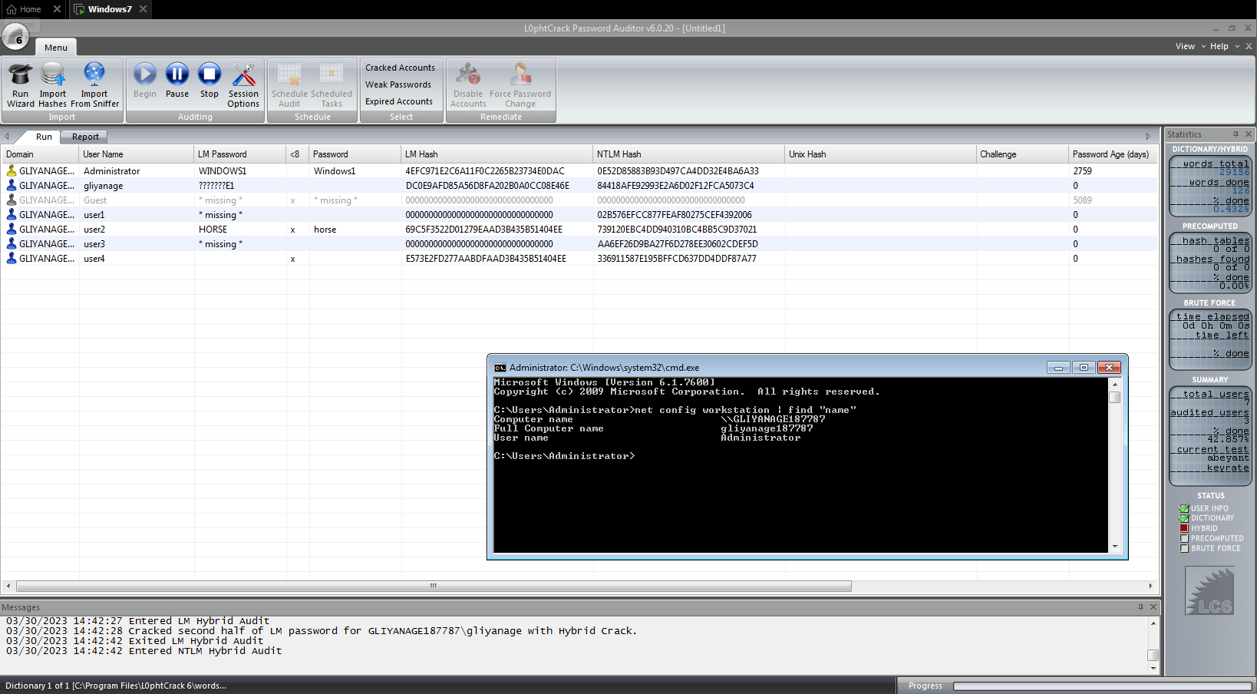
Screen Shot 5
How is this password crack different from the previous attempts passwords?
The LM hash is a weak encryption algorithm that was used for password storage in earlier versions of Windows. If the "Network Security: Do not store LAN Manager hash value on next password change" policy is enabled, Windows will not store the LM hash, making it more difficult for attackers to crack passwords using the LM hash. Even if the LM hash is not saved, L0phtcrack can still try to crack passwords using other methods, such as brute-force or dictionary attacks.
6

